Slide 1
Predicting car accident severity

Slide 2
Predicting severity of accident is valuable for ordinary people
It would be great if there is something in place that could warn you about a car accident, given the weather and the road conditions about the possibility of you getting into a car accident and how severe it would be, so that you would drive more carefully or even change your travel if you are able to.

Slide 3
Data acquisition and cleaning
All collisions provided by SPD and recorded by Traffic Records
In total 194673 rows and 38 features in the raw dataset
Duplicate and features with too much missing values were dropped
Categorical features were transformed into it’s dummies
Final dataset has 67 features

Slide 4
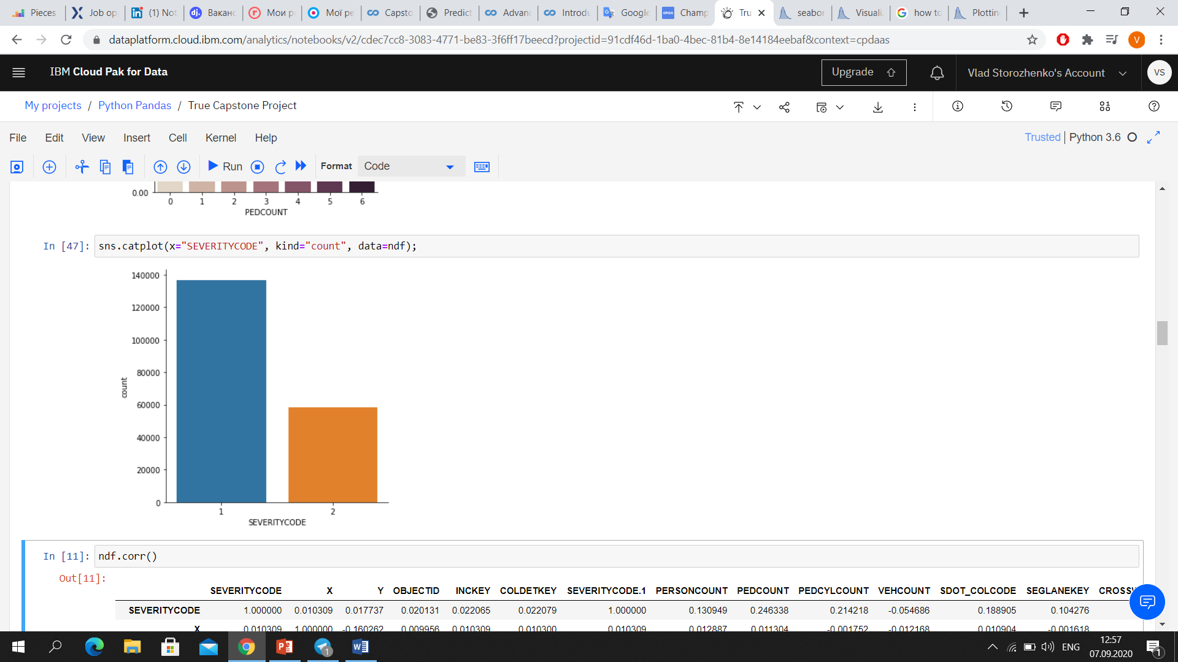
Severity distribution

Slide 5
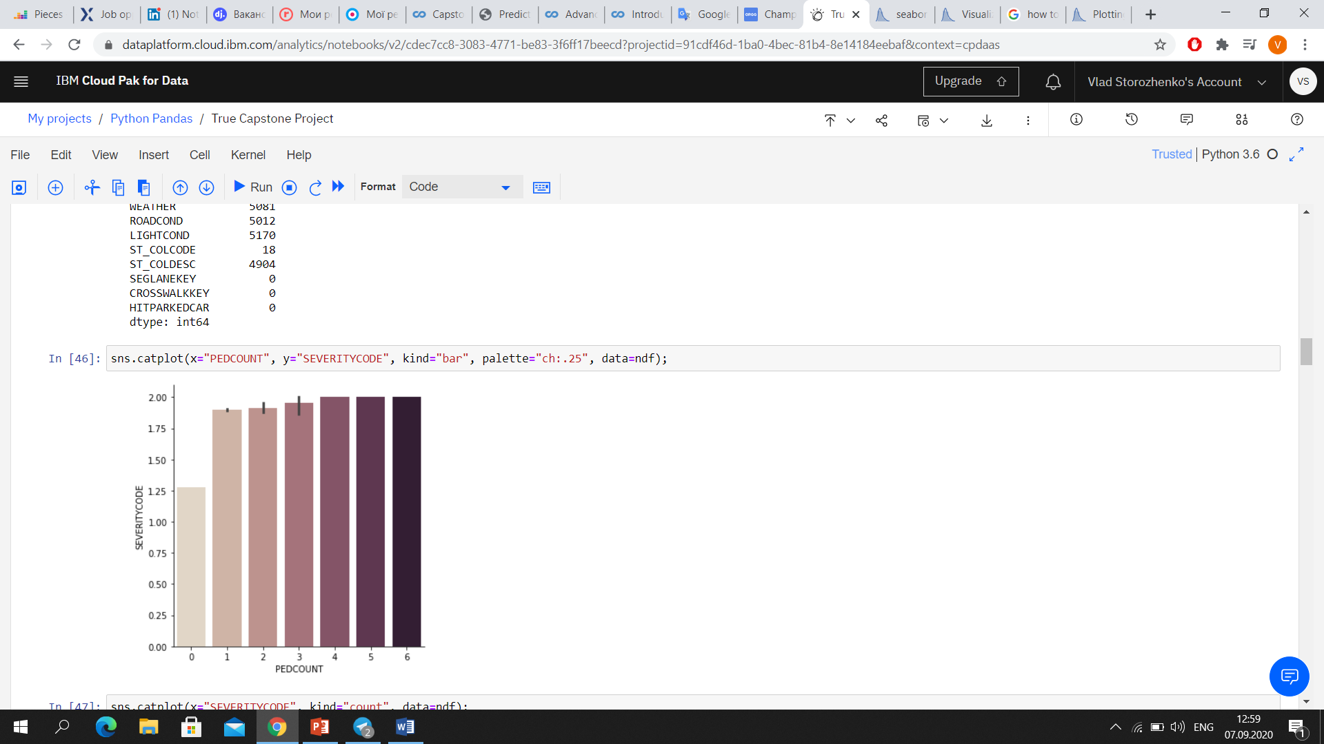
Severity of accident depends on number of pedestrians that were involved in car accident

Slide 6
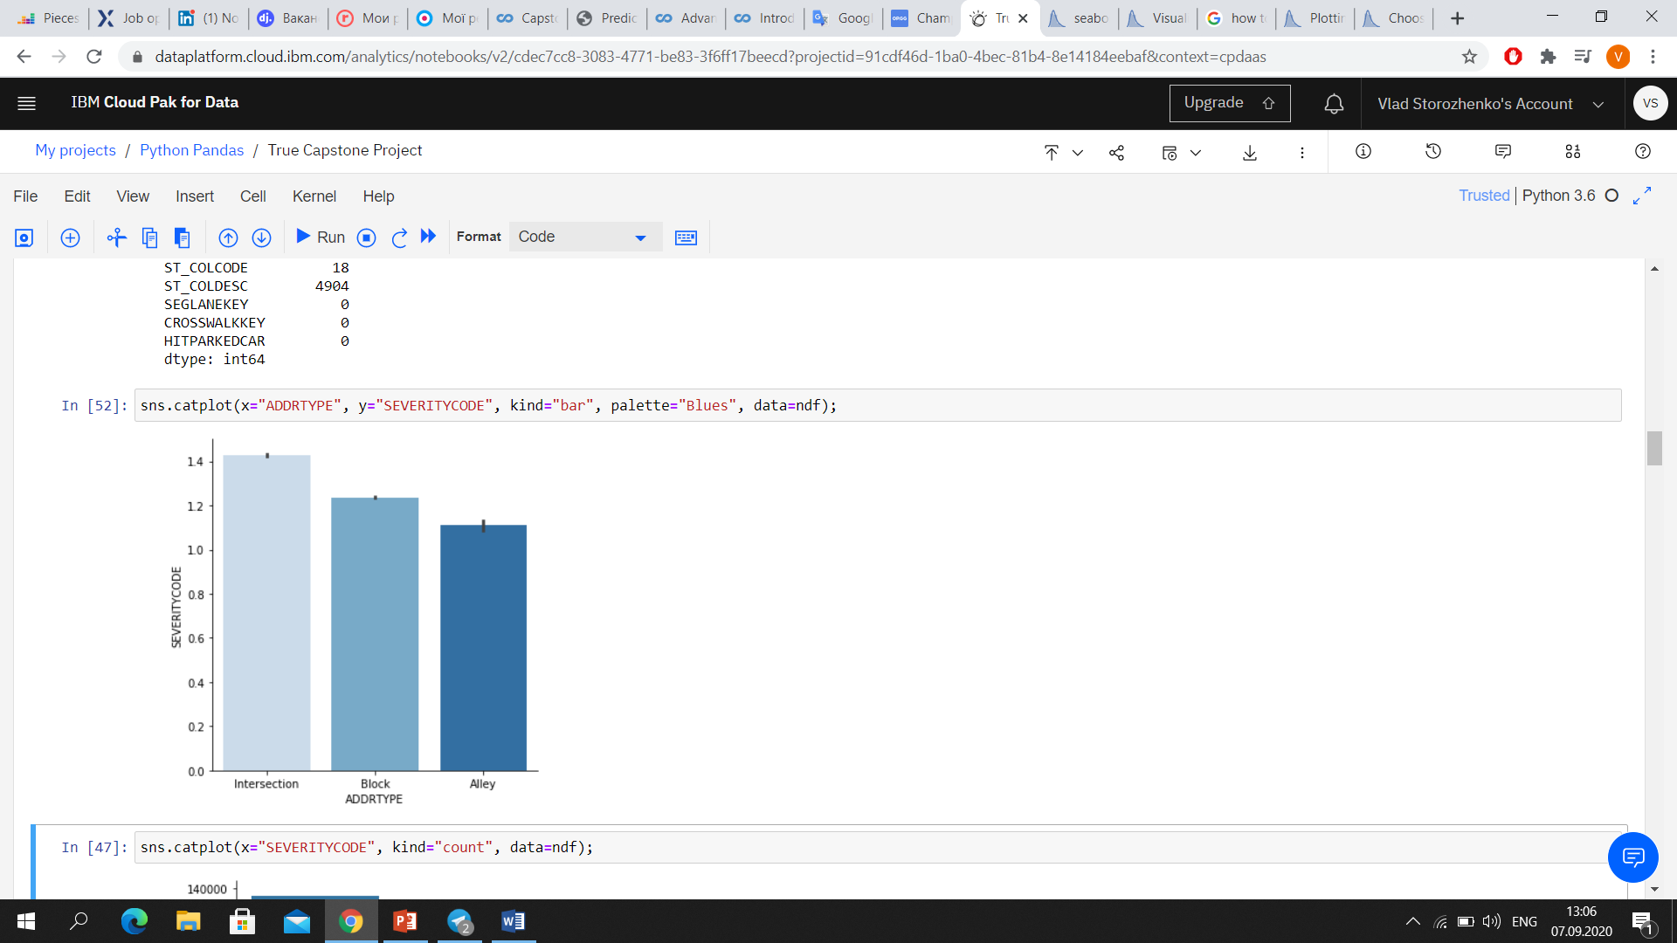
Intersection type of collision address has tendency to higher severity

Slide 7
Classification models
Accuracy:
SVM: 0.9995
Decision tree: 1.0
Logistic Regression: 1.0
Logistic regression performed the best with accuracy = 1.0 and log loss =0.0004

Slide 8
Conclusion
Built useful models to predict severity of car accident.
Data was preprocessed for further using
Accuracy of the models is perfect.

